Slide 1
Lecture 4
DTMC – Initial Condition and
Random Walk

Slide 2
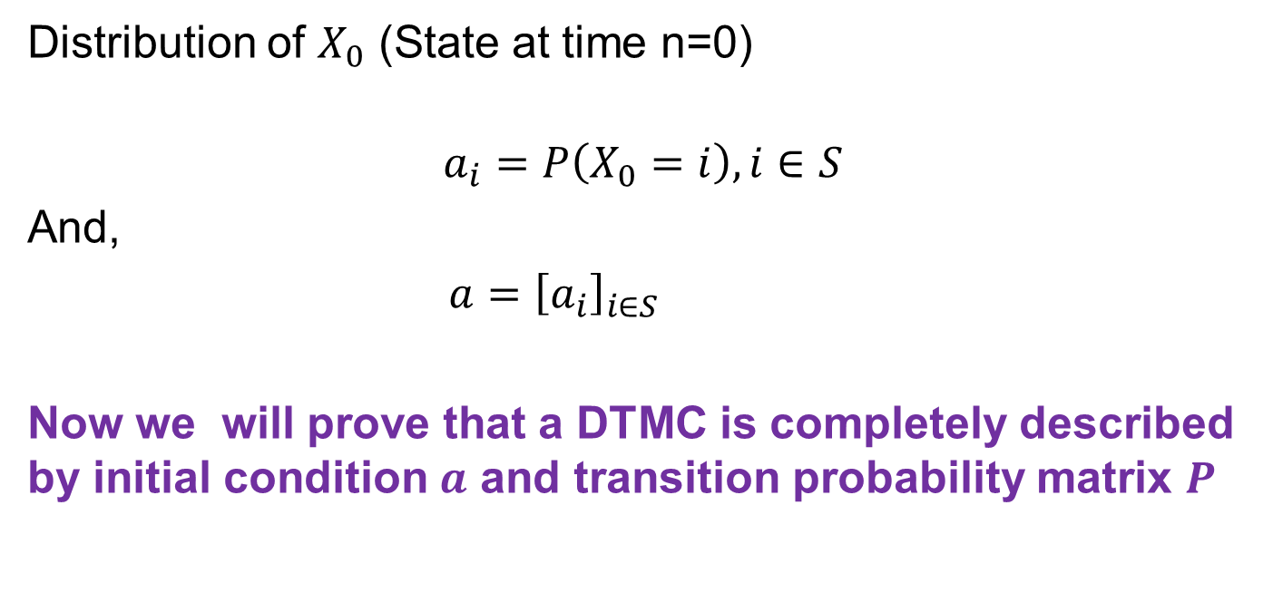
Initial Condition
Distribution of $X_{0}$ (State at time n=0)
$$a_{i}=P\left(X_{0}=i\right), i∈S$$
And,
$a={\left[a_{i}\right]}_{i∈S}$
Now we will prove that a DTMC is completely described by initial condition $a$ and transition probability matrix $P$

Slide 3
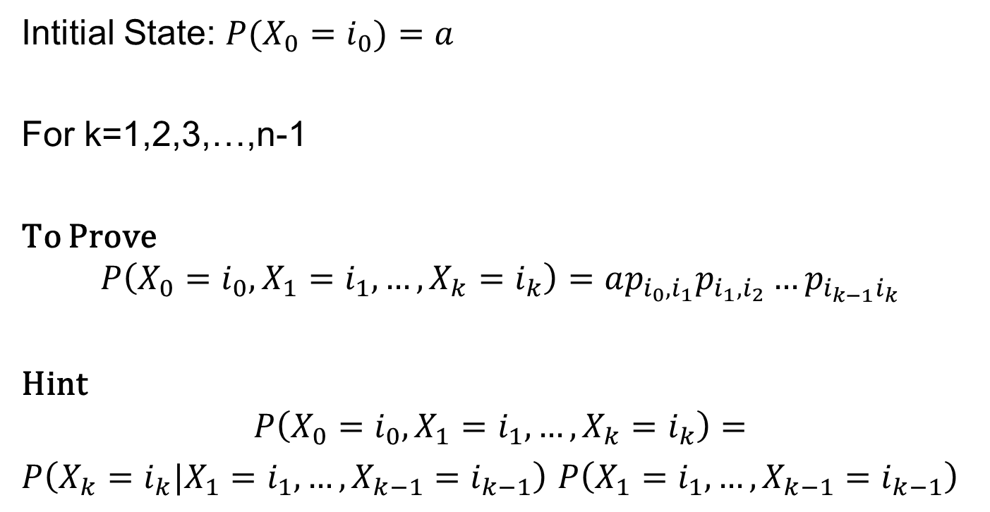
DTMC: Initial Condition and Transition Probability
Intitial State: ${P(X}_{0}=i_{0})=a$
For k=1,2,3,…,n-1
To Prove
$$P\left(X_{0}=i_{0},X_{1}=i_{1},…,X_{k}=i_{k}\right)=ap_{i_{0},i_{1}}p_{i_{1},i_{2}}…p_{i_{k−1}i_{k}}$$
Hint
$$P\left(X_{0}=i_{0},X_{1}=i_{1},…,X_{k}=i_{k}\right)=$$
$P\left(X_{k}=i_{k}|X_{1}=i_{1},…,X_{k−1}=i_{k−1}\right)$ $P\left(X_{1}=i_{1},…,X_{k−1}=i_{k−1}\right)$

Slide 4

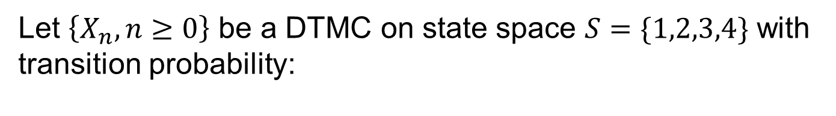

Example 3
Let $\left\{X_{n},n≥0\right\}$ be a DTMC on state space $S=\{1,2,3,4\}$ with transition probability:
0.1 0.2 0.3 0.4
0.2 0.2 0.3 0.3
0.5 0.0 0.5 0.0
0.6 0.2 0.1 0.1
$$P=$$
And initial condition a$=[0.25, 0.25, 0.25, 0.25]$

Slide 5
Example 3 – Question 1
Compute $P(X_{3}=4, X_{2}=1, X_{1}=3, X_{0}=1$)

Slide 6
Example 3 – Question 2
Compute $P(X_{3}=4, X_{2}=1, X_{1}=3$)

Slide 7
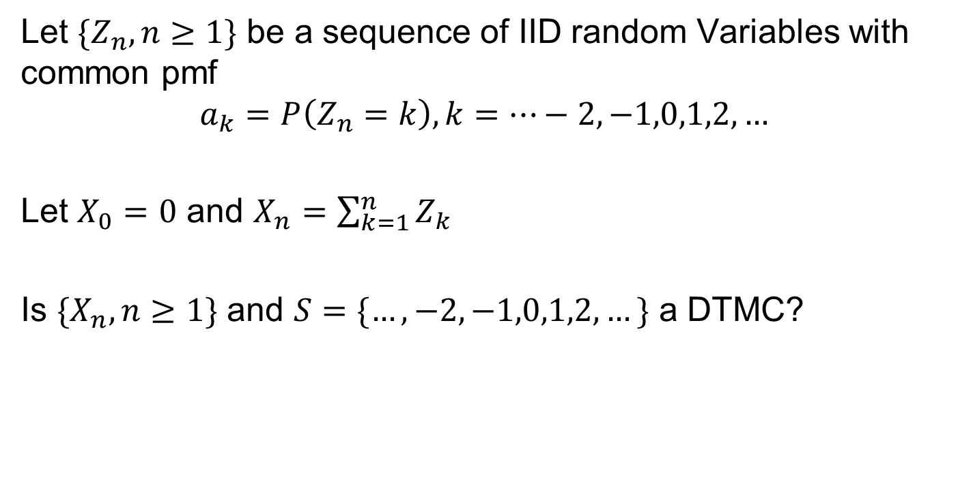
Random Walk
Let ${\{Z}_{n}, n≥1\}$ be a sequence of IID random Variables with common pmf
$$a_{k}=P\left(Z_{n}=k\right), k=…−2,−1,0,1,2,…$$
Let $X_{0}=0$ and $X_{n}=\sum_{k=1}^{n}{Z_{k}}$
Is ${\{X}_{n}, n≥1\}$ and $S=\{…,−2,−1,0,1,2,…\}$ a DTMC?

